Slide 1



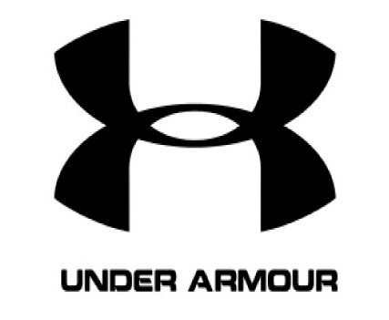




Multidimensional Scaling on Sportswear Brands(Football)
Michael Oppong
11-01-2023

Slide 2
Original Data

Slide 3
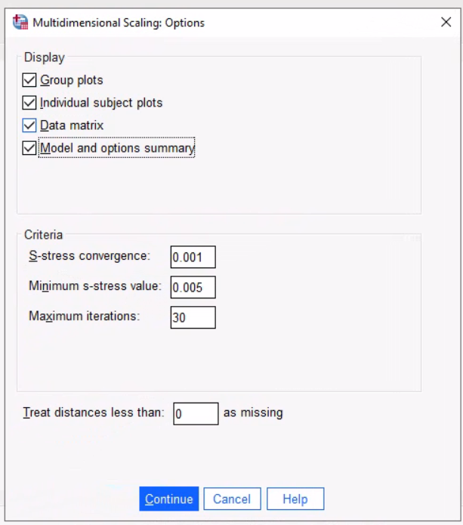
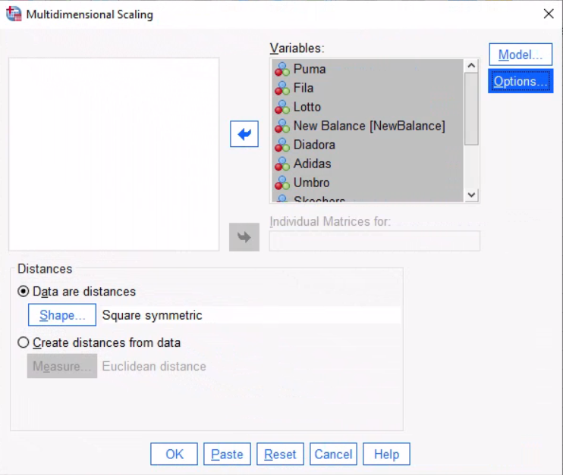
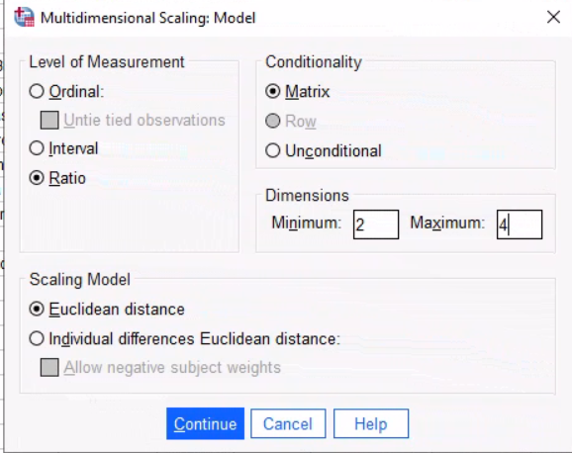

Slide 4
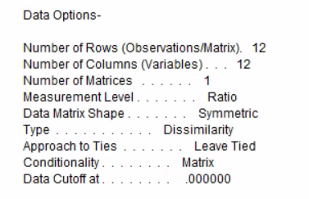
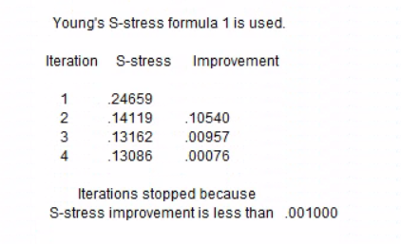
This value looks like an error. Please check.
Also, I assume that you will explain this table during your presentation.

Slide 5
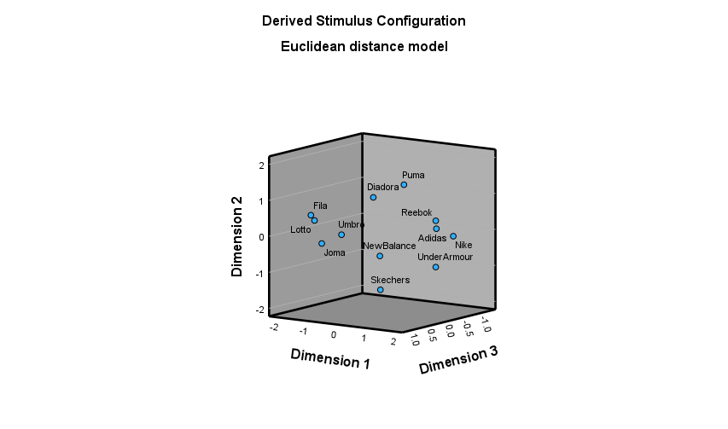

Slide 6
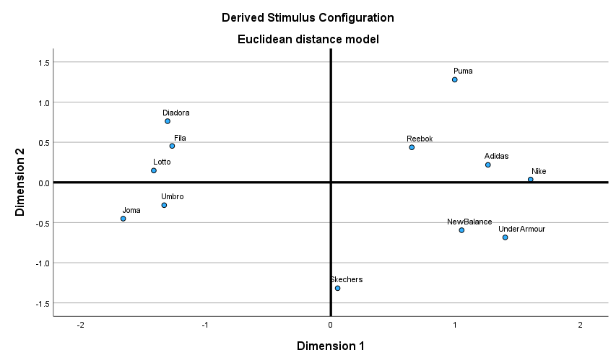

Slide 7
You need to label the axes, not the quadrants. For example, instead of your red and green double-headed arrows, you need one, single-headed arrow saying Popularity or Market Dominance. Is that the X-axis or Y-axis?
1
2
Sophisticated designs, following trends
Not very popular brands
Dominant Brands in the market
Strength, durability and fortitude
3
4

Slide 8
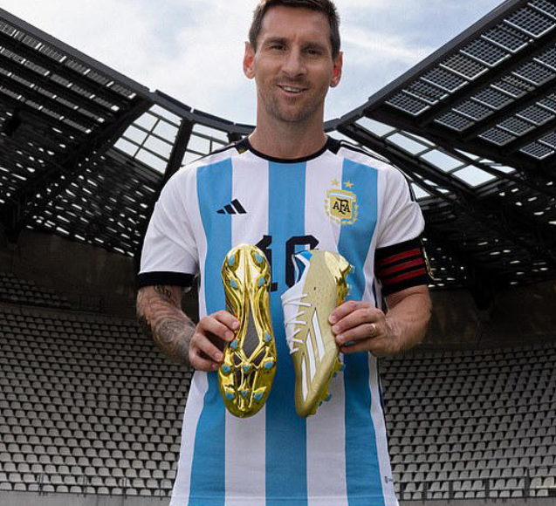
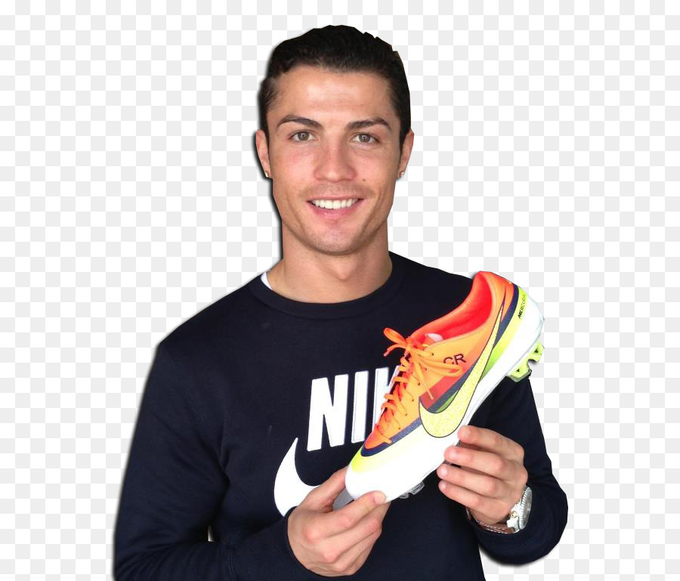
QUESTIONS ?

